Slide 1
A Survey of Deep Learning and Foundation Models for Time Series Forecasting
Speaker: Ching (Jason) Chang
Supervisor: Wen-Chih (Chris) Peng

Slide 2
Outline
Introduction
What is time-series data?
What is time-series forecasting?
Methods
Statistical and Deep Learning Models
Transformers
Graph Neural Networks (GNNs)
Foundation Models
Evaluation
Metrics
Datasets
Quality Findings

Slide 3
Introduction

Slide 4
Tabular Data ≠ Time Series Data
features
features
x1
x2
x3
y
f1
f2
f3
data window
data window
time

Slide 5
Group POV (case 1)
Irregular Time-Series Data
We also care about the ordering
S1
S2
S3
S4
S5
S6
S7
S1
S2
wafer id | f1 (M) | S1_f1 (M) | S2_f2 (M) | S3_f1 (Q) | S3_f2 (M) | … | S7_f1 (Q)
W1 | PART1 | RCP1 | 7.3 | XXX | 23 | … | 22
W2 | PART1 | RCP1 | 1.6 | XXX | 45 | … | 31
W3 | PART1 | RCP1 | 0.4 | XXX | 30 | … | 13
W4 | PART2 | RCP2 | 0.2 | XXX | 14 | … | 24
W5 | PART2 | RCP2 | 0.9 | XXX | 36 | … | 34
… | … | … | … | … | … | … | …
W97 | PART3 | RCP1 | 3.7 | XXX | 30 | … | 23
W98 | PART3 | RCP2 | 1.6 | XXX | 45 | … | 67
W99 | PART3 | RCP2 | 0.5 | XXX | 64 | … | 83
W100 | PART3 | RCP2 | 3.5 | XXX | 12 | … | 80
S3
S4
S5
S6
S7
causal graph

Slide 6
Individual POV (case 2)
Tabular Data
We treat each wafer individually
S1
S2
S3
S4
S5
S6
S7
S1
S2
wafer id | f1 (M) | S1_f1 (M) | S2_f2 (M) | S3_f1 (Q) | S3_f2 (M) | … | S7_f1 (Q)
W1 | PART1 | RCP1 | 7.3 | XXX | 23 | … | 22
W2 | PART1 | RCP1 | 1.6 | XXX | 45 | … | 31
W3 | PART1 | RCP1 | 0.4 | XXX | 30 | … | 13
W4 | PART2 | RCP2 | 0.2 | XXX | 14 | … | 24
W5 | PART2 | RCP2 | 0.9 | XXX | 36 | … | 34
… | … | … | … | … | … | … | …
W97 | PART3 | RCP1 | 3.7 | XXX | 30 | … | 23
W98 | PART3 | RCP2 | 1.6 | XXX | 45 | … | 67
W99 | PART3 | RCP2 | 0.5 | XXX | 64 | … | 83
W100 | PART3 | RCP2 | 3.5 | XXX | 12 | … | 80
S3
S4
S5
S6
S7
causal graph

Slide 7
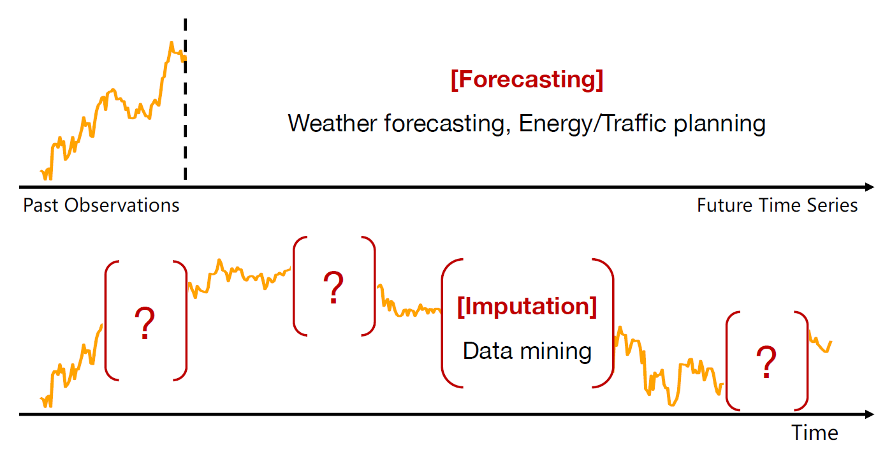
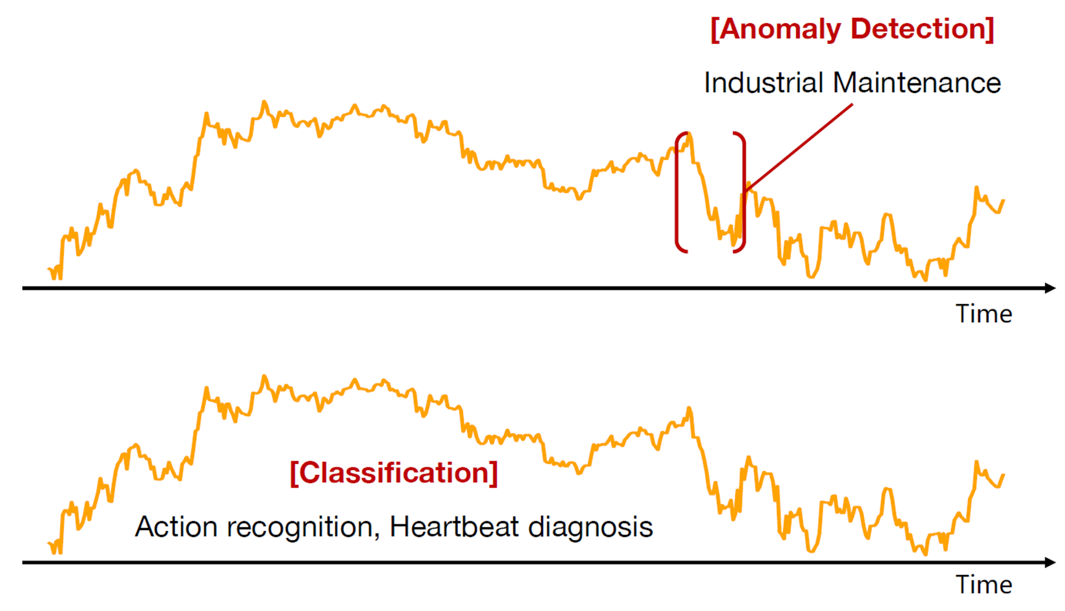
Time-Series Tasks
Forecasting
Long-term Forecasting
Short-term Forecasting
Imputation
Anomaly Detection
Classification
https://wuhaixu2016.github.io/pdf/ICLR2023_TimesNet.pdf

Slide 8



Problem Formulation for Forecasting
$$stride=1$$
past
future
$$X_{P}=(x_{1},…,x_{L})$$
$$X_{F}=(x_{L+1},…,x_{L+T})$$
forecast

Slide 9
Methods

Slide 10
Statistical and Deep Learning Models
Statistical Models
ARIMA
Deep Learning Models
LSTM/GRU
CNN
TCN-based
TCN, TimesNet
N-BEATS
Linear-based
DLinear, RLinear
MLP-based
TSMixer
TiDE
TimeMixer

Slide 11
Transformers
Informer
Autoformer
FEDformer
Crossformer
PatchTST
iTransformer

Slide 12
Graph Neural Networks (GNNs)
GCN
GAT
GIN
TGN

Slide 13
Foundation Models
Repurposed LLMs
GPT4TS, LLM4TS, TEMPO
Broadly Pre-trained on Time-Series Datasets
TimeGPT, TimesFM, Lag-Llama
Pre-trained on Domain-related Time-Series Datasets
AutoMixer
Multimodal with Text and Time-Series
Time-LLM, UniTime

Slide 14
Evaluation

Slide 15
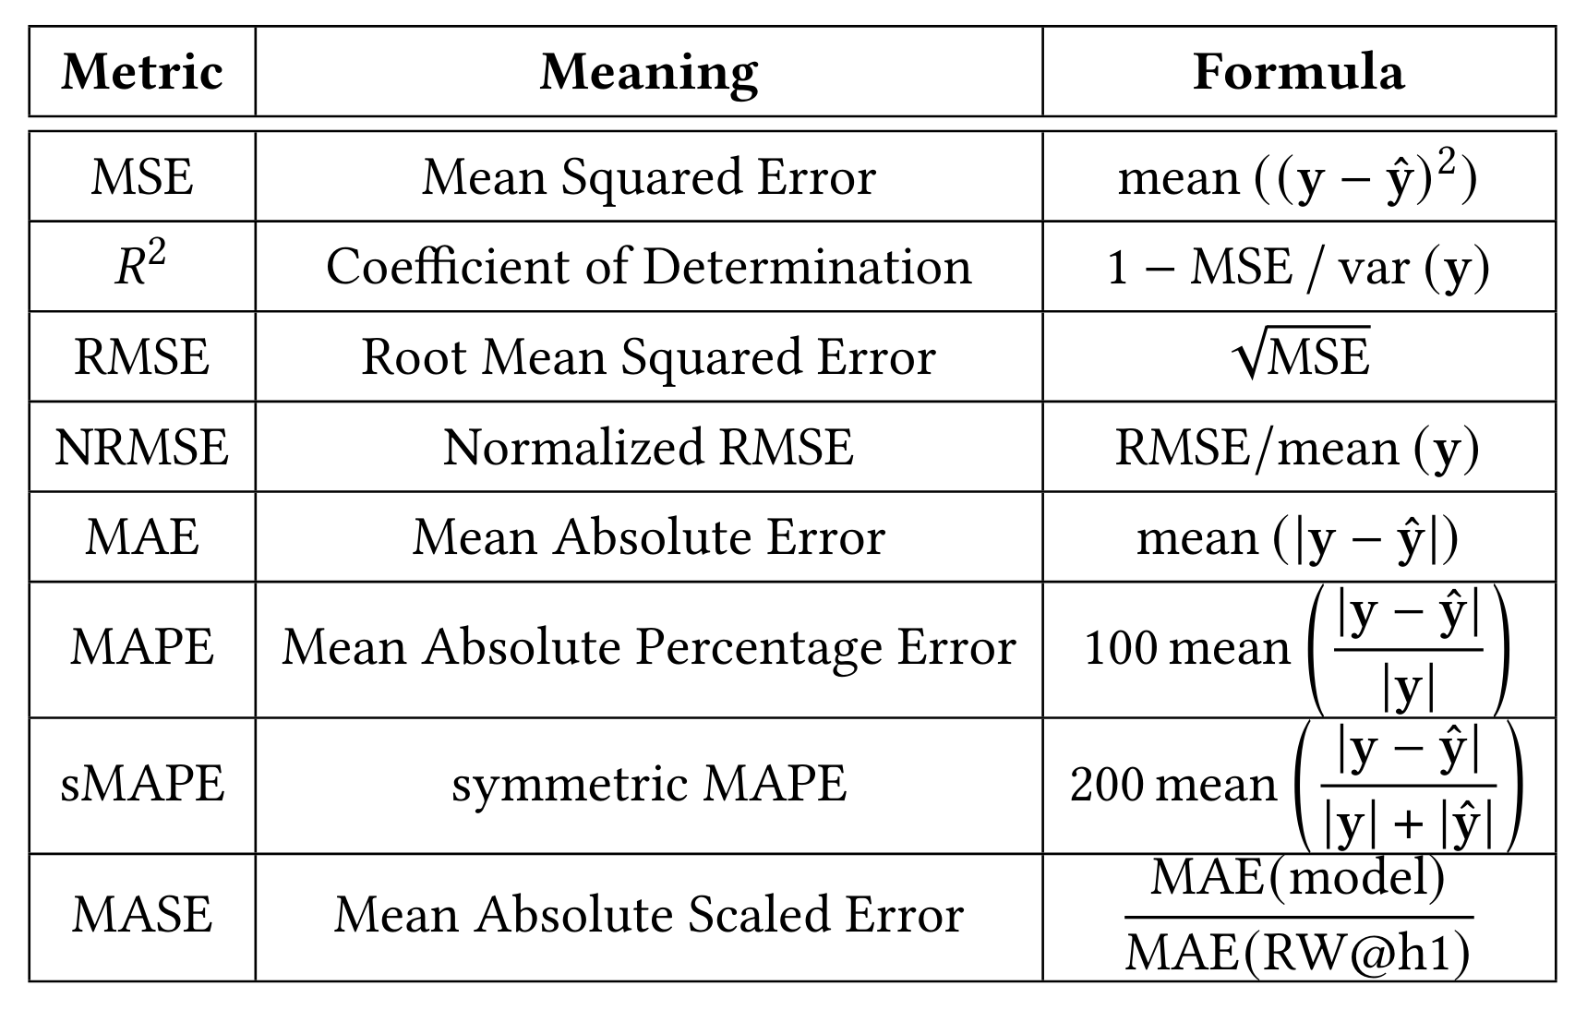
Metrics

Slide 16
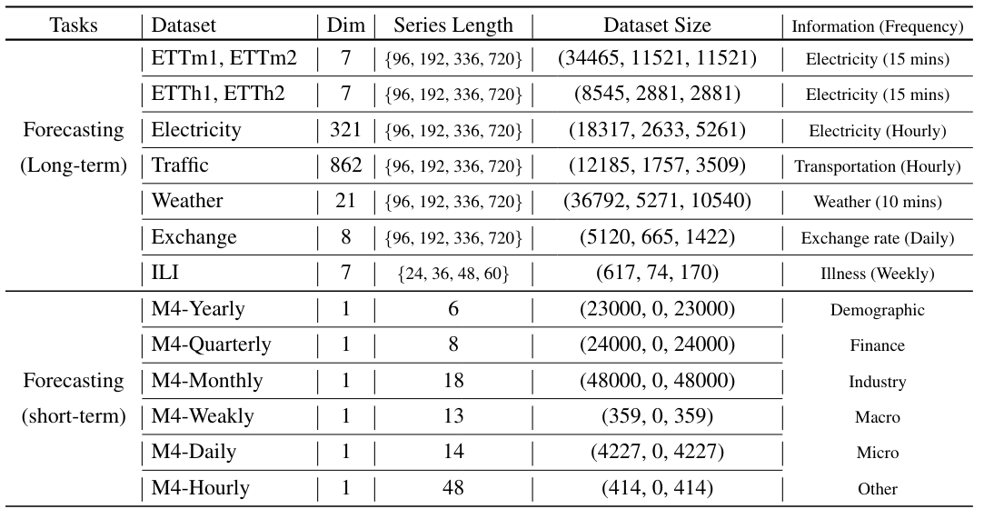
Datasets

Slide 17
Quality Findings

Slide 18
Quality Findings
Look-back window
Channel Mixing vs. Channel Independence
Temporal Embeddings
Instance Normalization
Layer Normalization vs. Batch Normalization
Residual Attention

